Slide 1
EduVision_DV
Higher Education Performance Dashboard
A Unified Higher Education Intelligence System
Presented by: Palle Chandana
Technologies: Python | Excel | Tableau | GitHub

Slide 2
Introduction & Problem Statement
I
II
III
Introduction
Problem Statement
Proposed Solution
EduVision_DV is a higher-education analytics project designed to analyze university performance, research indicators, student-related metrics, and country-level education information.
Higher-education data is distributed across multiple sources with different formats and indicators. This makes it difficult to compare universities and countries consistently.
Develop a unified data model and interactive Tableau dashboards to simplify higher-education performance analysis.

Slide 3
Project Objectives
1
Collect and inspect the selected education datasets.
5
Create a unified data model.
2
Clean and standardize university and country information.
6
Build four interactive Tableau dashboards.
3
Integrate data from multiple sources.
7
Compare university and country performance.
4
Develop six core performance KPIs.
8
Validate KPI calculations, rankings, and dashboard interactions.
Goal: Transform raw education data into meaningful analytical insights.

Slide 4
Data Sources
1
QS World University Rankings
2
Times Higher Education
University ranking information
Academic reputation indicators
University performance indicators
Research-related information
3
World University Rankings
4
World Bank Education Data
Research information
Student and faculty-related indicators
Country-level education indicators
Education benchmarking information
These sources provide different perspectives for university and country comparison.

Slide 5
Data Preparation
Data Collection
Data Cleaning
Data Standardization
Collected the selected datasets and inspected their structure, columns, and available records.
Checked duplicate records.
Standardized university and country names.
Corrected data types.
Inspected missing values.
Validated ranking and score fields.
Prepared consistent data structures for integration and analysis.
Key Principle: Original source data was preserved, and missing KPI values were not replaced with fabricated values.

Slide 6
Data Integration & Data Model
Dimension Tables
Fact Tables
KPI Table
dim_university
dim_country
fact_university_performance
fact_research
fact_student
fact_country_education
KPI_Table
Integration Approach University and country information is organized into a common analytical structure to support consistent analysis and Tableau visualization.
DATA FLOW
Cleaned Datasets
→
Integrated Data Model
→
KPI Dataset
→
Tableau

Slide 7
Six Core KPIs
1
Global Ranking Score
2
Research Impact Score
3
Faculty-to-Student Ratio
Represents university ranking performance.
Measures research-related performance using available indicators.
Represents the number of students per faculty member.
4
International Student Percentage
5
Academic Reputation Score
6
Research Productivity Index
Represents the proportion of international students.
Represents the academic reputation indicator.
Represents a composite research-performance indicator.
These KPIs provide a structured basis for comparing universities and supporting dashboard analysis.

Slide 8
Tableau Dashboard Development
1
Connect the prepared datasets to Tableau.
5
Assemble worksheets into four dashboards.
2
Create individual worksheets for analytical indicators.
6
Configure filters and interactive selections.
3
Configure rankings, measures, and aggregations.
7
Test dashboard layout, navigation, and responses.
4
Design comparative charts and KPI visualizations.
Outcome: A unified Tableau workbook for higher-education analytics.

Slide 9
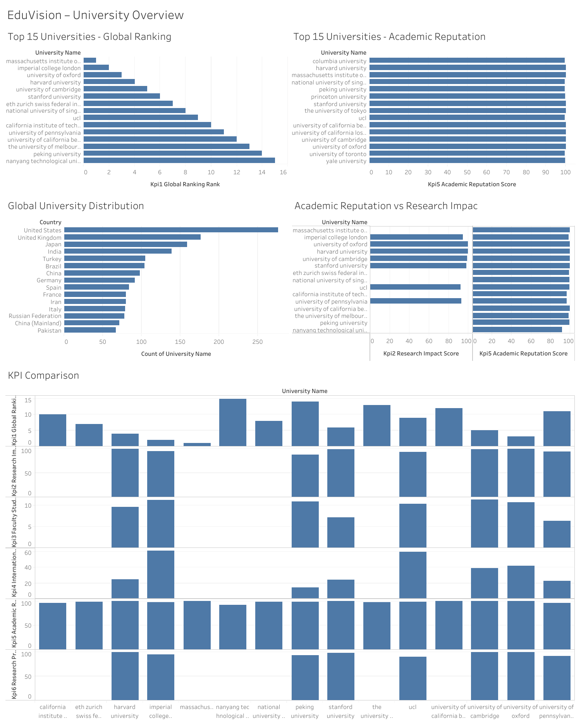
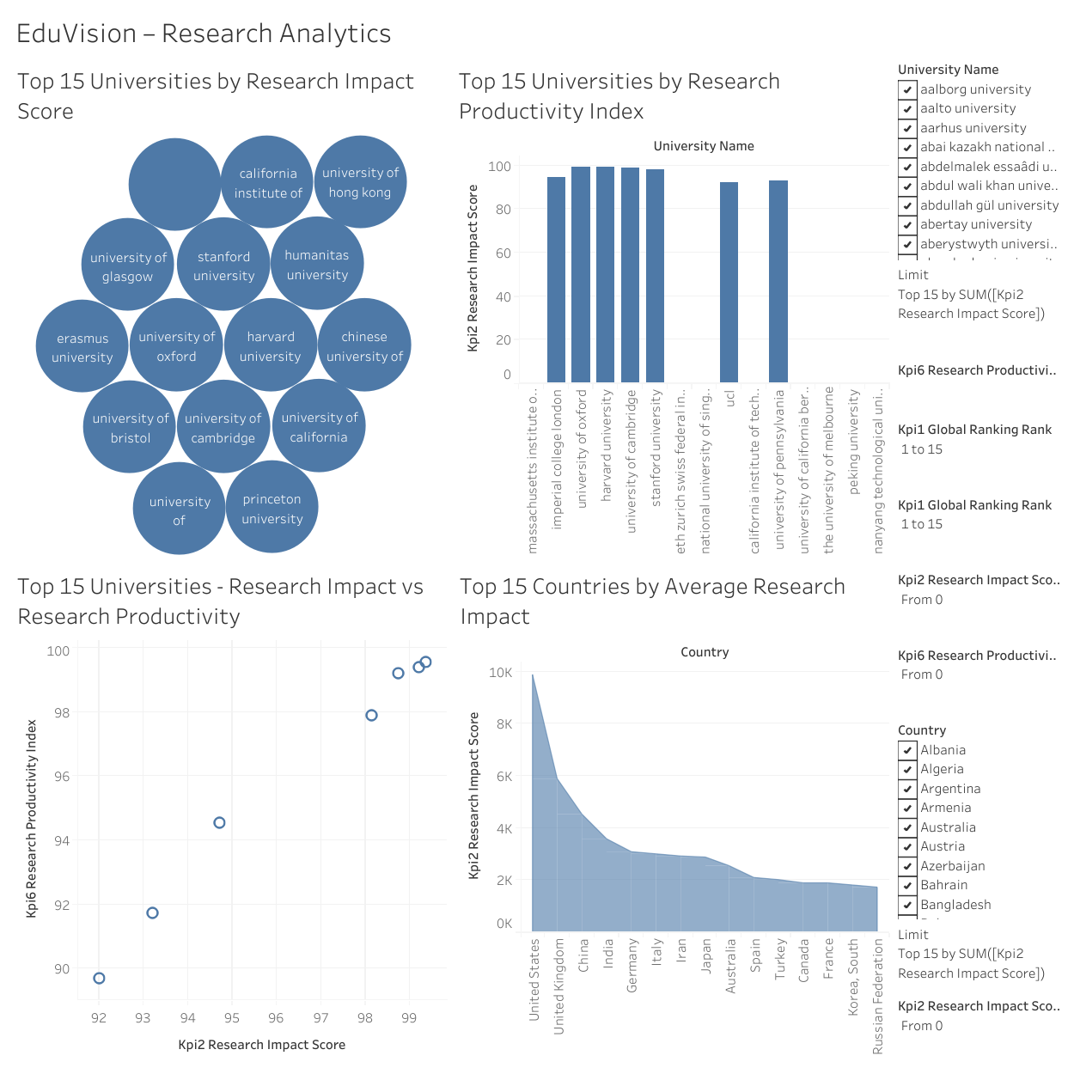
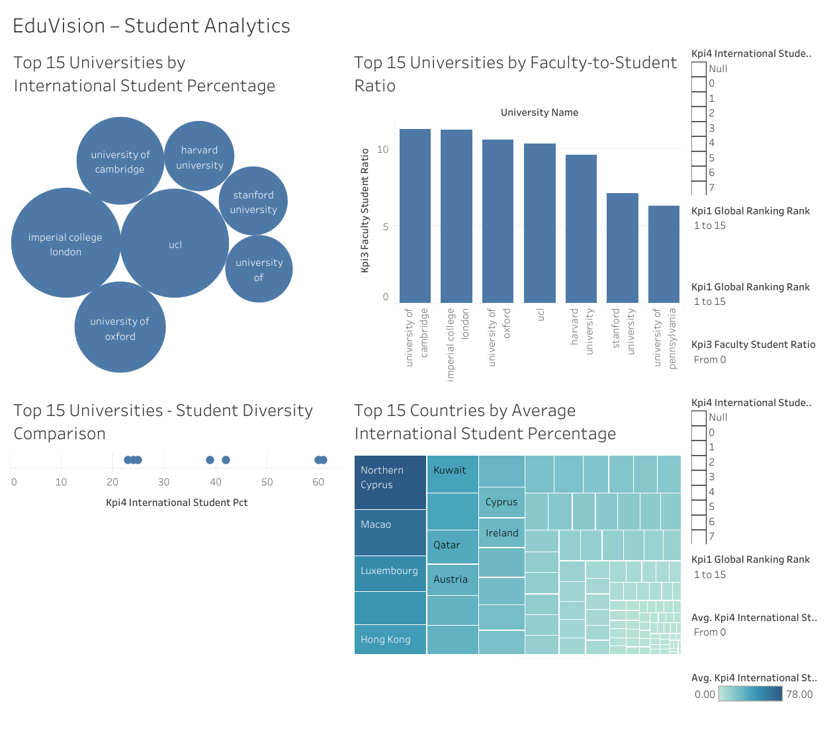
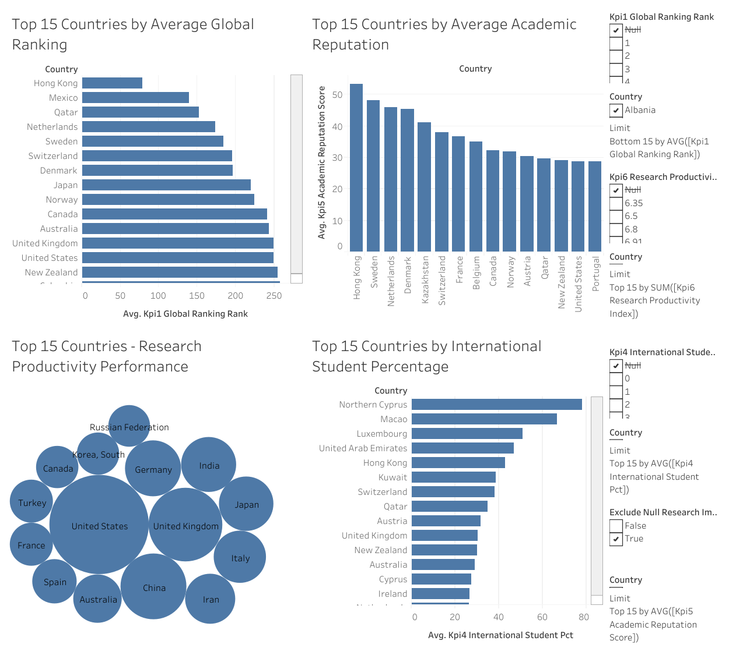
EduVision_DV — Dashboard Outputs
Global university ranking
Academic reputation comparison
Global university distribution
Reputation versus research impact
KPI comparison
Research impact
Research productivity
Research impact versus productivity
Country-level research impact
1. University Overview
2. Research Analytics
International student percentage
Faculty-to-student ratio
Student diversity comparison
Country-level international student percentage
Average global ranking
Academic reputation comparison
Research productivity performance
International student percentage
3. Student Analytics
4. Country Comparison
Notes:
Replace each dashed placeholder with the matching Tableau dashboard screenshot (2 x 2 layout). Keep the dashboard names underneath.
1. University Overview: Global university ranking, Academic reputation comparison, Global university distribution, Reputation versus research impact, KPI comparison.
2. Research Analytics: Research impact, Research productivity, Research impact versus productivity, Country-level research impact.
3. Student Analytics: International student percentage, Faculty-to-student ratio, Student diversity comparison, Country-level international student percentage.
4. Country Comparison: Average global ranking, Academic reputation comparison, Research productivity performance, International student percentage.

Slide 10
Dashboard Interactions & Analysis
The Tableau dashboards allow users to explore and compare higher-education performance through:
1
University selection
2
Country selection
3
Ranking-based comparisons
4
Interactive charts and filters
5
KPI tooltips
6
Dashboard-level analysis
ANALYTICAL APPROACH
Select
→
Filter
→
Compare
→
Analyze
Missing Data Handling: Missing KPI values are retained as NULL where source information is unavailable. NULL values are not treated as zero.

Slide 11
Testing & Quality Assurance
Data Validation
KPI & Ranking Validation
Dashboard Testing
Checked data quality and missing values.
Reviewed duplicate and invalid records.
Verified university and country information.
Reviewed the six KPI fields.
Checked ranking order and displayed values.
Tested university selection.
Tested relevant country comparisons.
Checked dashboard navigation.
Reviewed chart readability and layout.
Checked missing-value behavior.
Testing Result: The dashboards were reviewed for data accuracy, usability, layout, and interaction. Research Analytics has a partial interaction limitation where some research KPI data is unavailable.

Slide 12
Final Output & Conclusion
EduVision_DV — Higher Education Performance Dashboard
Project Deliverables
Conclusion
Future Scope
Collected and cleaned datasets
Integrated data model
Six core KPIs
Four Tableau dashboards
KPI validation worksheet
Ranking verification worksheet
QA checklist
Dashboard testing report
Project documentation
EduVision_DV brings higher-education datasets together in a unified analytical system. It provides comparative views of university rankings, research performance, student indicators, and country-level education metrics.
Incorporate newer datasets.
Extend historical analysis.
Add advanced benchmarking.
Explore predictive analytics.
Automate data updates.
THANK YOU | Palle Chandana

